Slide 1
Mental Health First Aid
An Introduction
Mental Health First Aid
Tanya, Troy and Cathy
Thursday 10th October 2024

Slide 2
First Aid
First aid is the help given to a person who is ill or injured before professional medical treatment can be obtained. The aims of any first aid are to:
Preserve life
2. Prevent further harm
3. Promote recovery
4. Provide comfort to the person who is ill or injured

Slide 3
What is Mental Health First Aid?
MHFA is the help offered to a person developing a mental health issue, experiencing a worsening of an existing mental health issue or in a mental health crisis. The first aid is given until appropriate professional help is received or until the crisis appears to have been resolved.
Aims of Mental Health First Aider are to:
Preserve life where a person may be at risk of harm to themselves or others
2. Provide help to prevent the mental health issue from becoming more serious
3. Promote recovery of good mental health
4. Provide comfort to a person with a mental health issue

Slide 4
Mental health issues are common
So what is our role as mental health first aider?
To listen and communicate in a non-judgemental way
To support
To guide to relevant professional help if necessary

Slide 5
‘For all our differences, an underlying need for good mental health is something all human beings share. And so, in building more mentally healthy communities, perhaps that which unites us truly is greater than what divides us’.
MHFA England 2016

Slide 6
Within our roles as Mental Health First Aiders, we are here if you need us, whether it be as a listening ear if you are experiencing any difficulties within day to day life, or as a support to guide you to useful resources or professional help.
The support we will offer will be confidential and non-judgemental.
We realise we work in a busy environment, but we will make time for you.

Slide 7
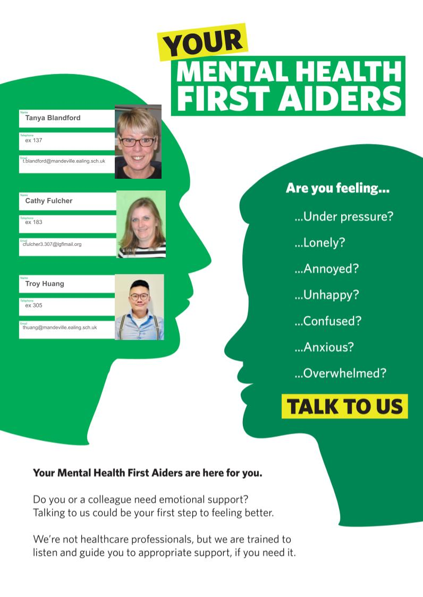
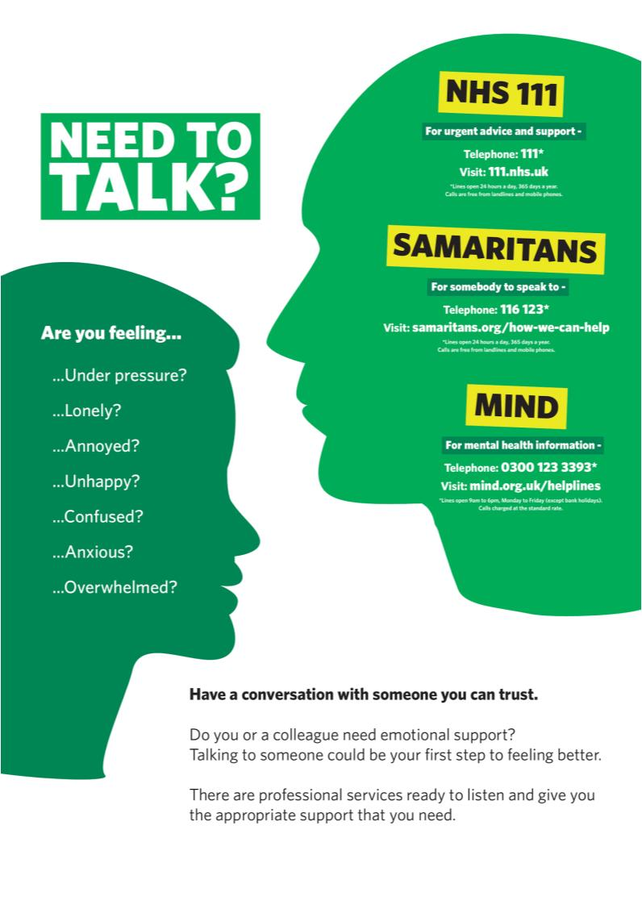

Slide 8
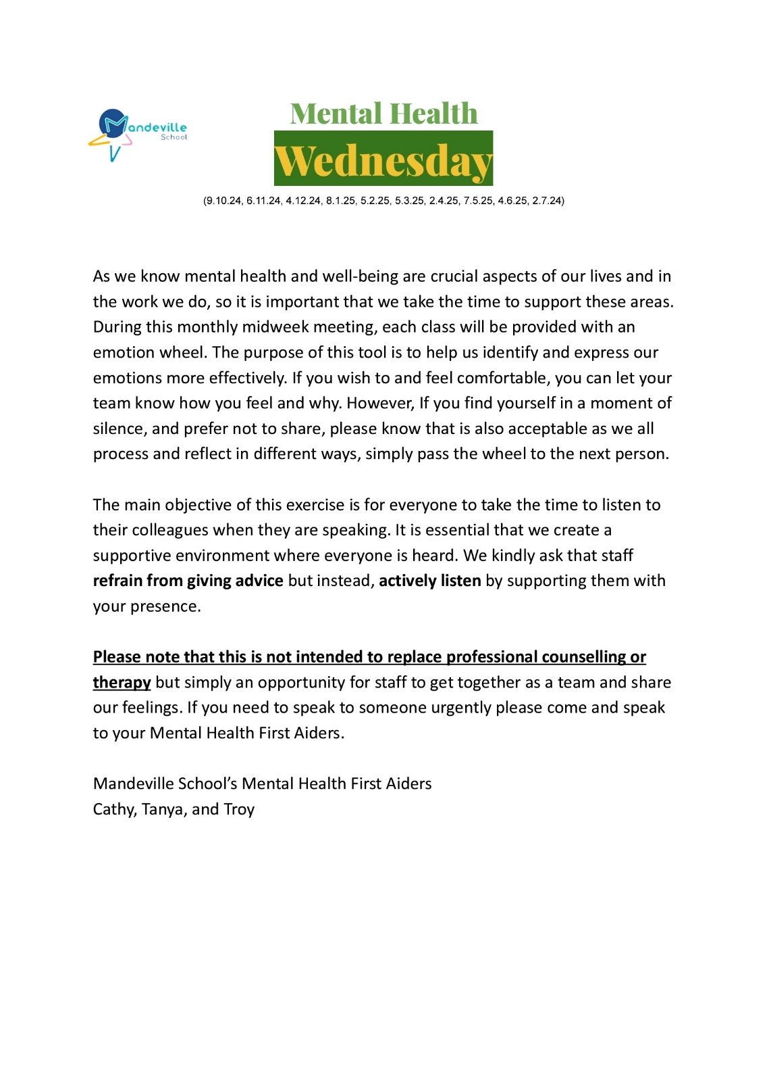
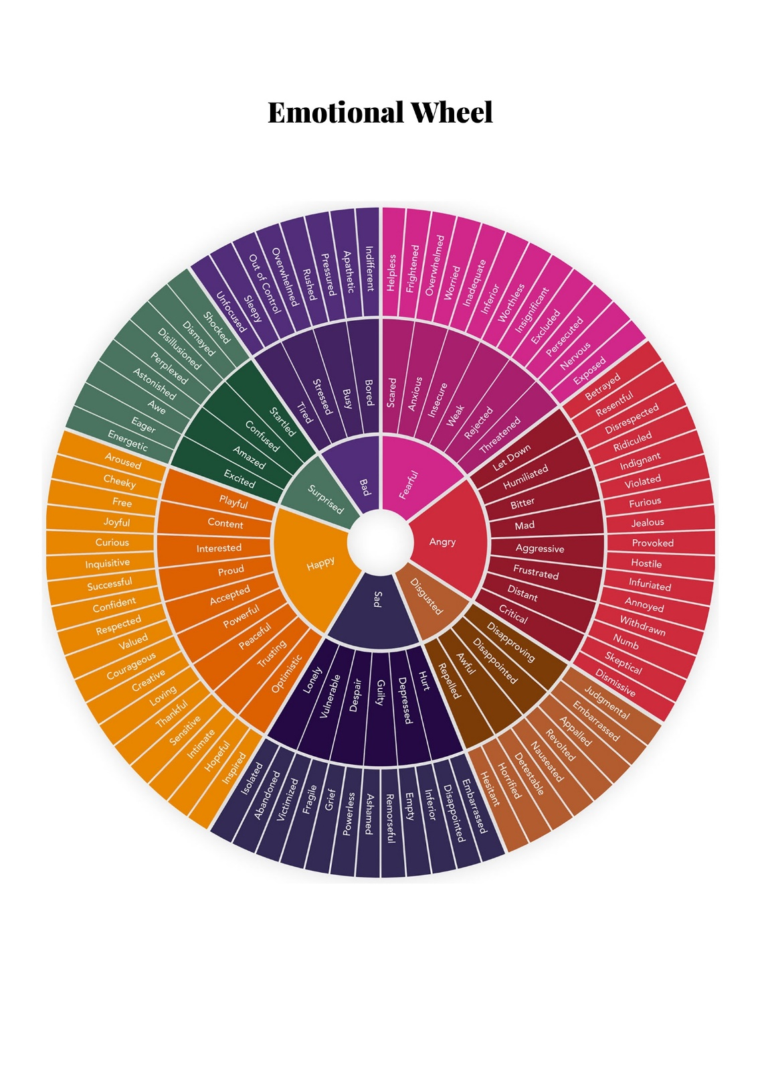

Slide 9








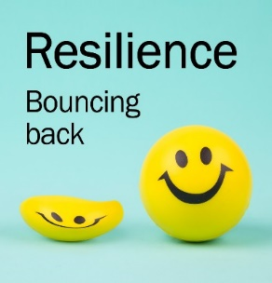


Ten Keys to Happiness
Giving – do things for others
Relating – connect with people
Exercising – take care of your body
Awareness – live life mindfully
Trying out – keep learning new things
Direction – have goals to look forward to
Resilience – find ways to bounce back
Emotions – look for what’s good
Acceptance – be comfortable with who you are
Meaning – be part of something bigger

