Slide 1
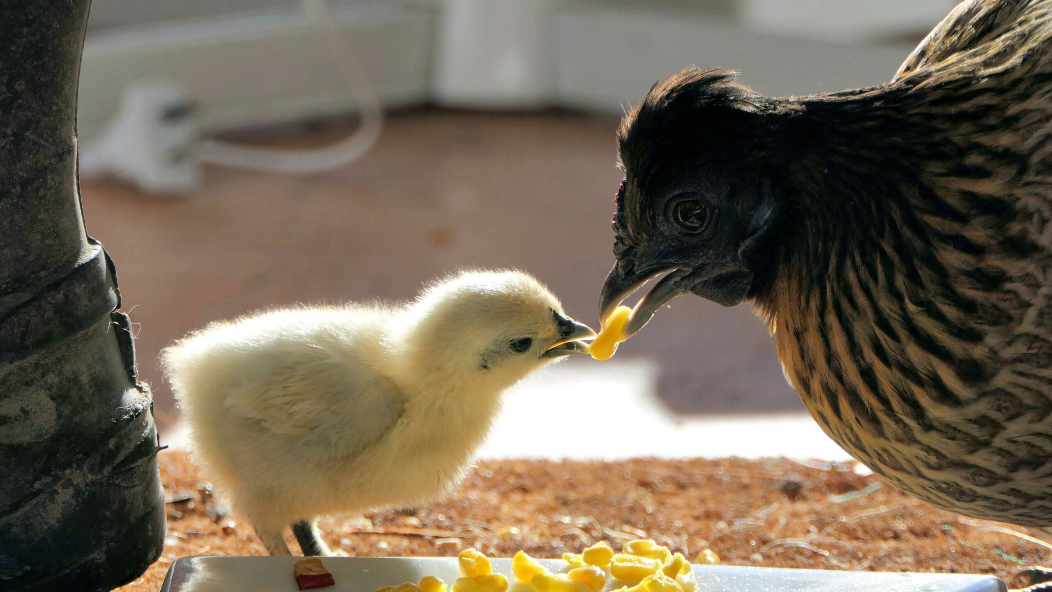
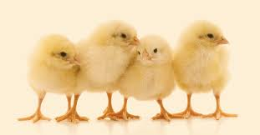
Old MacDonald had a farm
e-i-e-i-o

Slide 2
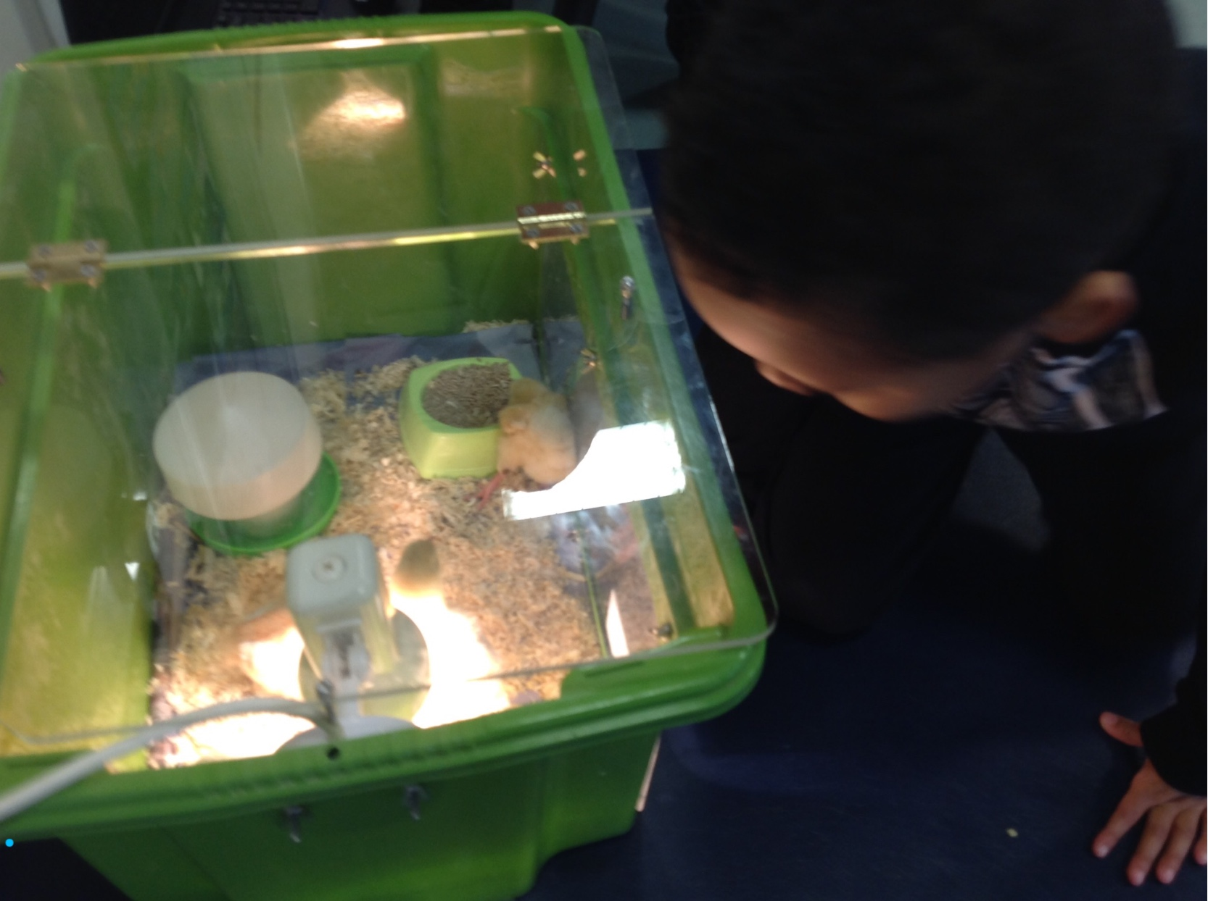
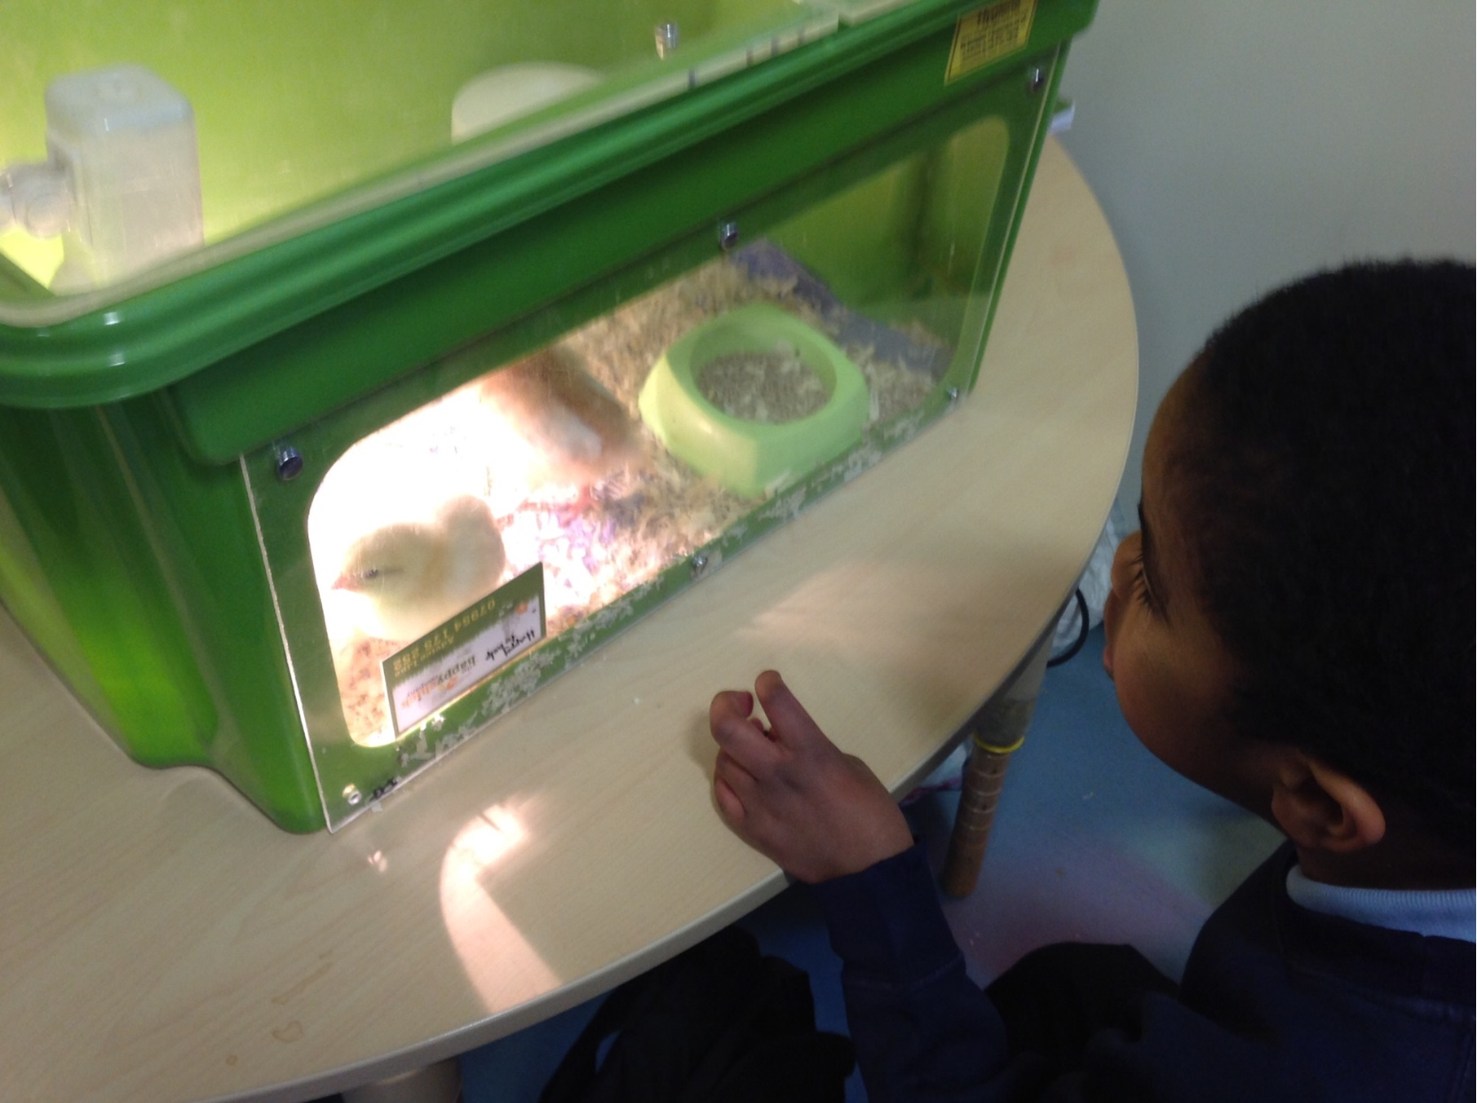
On that farm he had some chicks e-i-e-i-o.

Slide 3
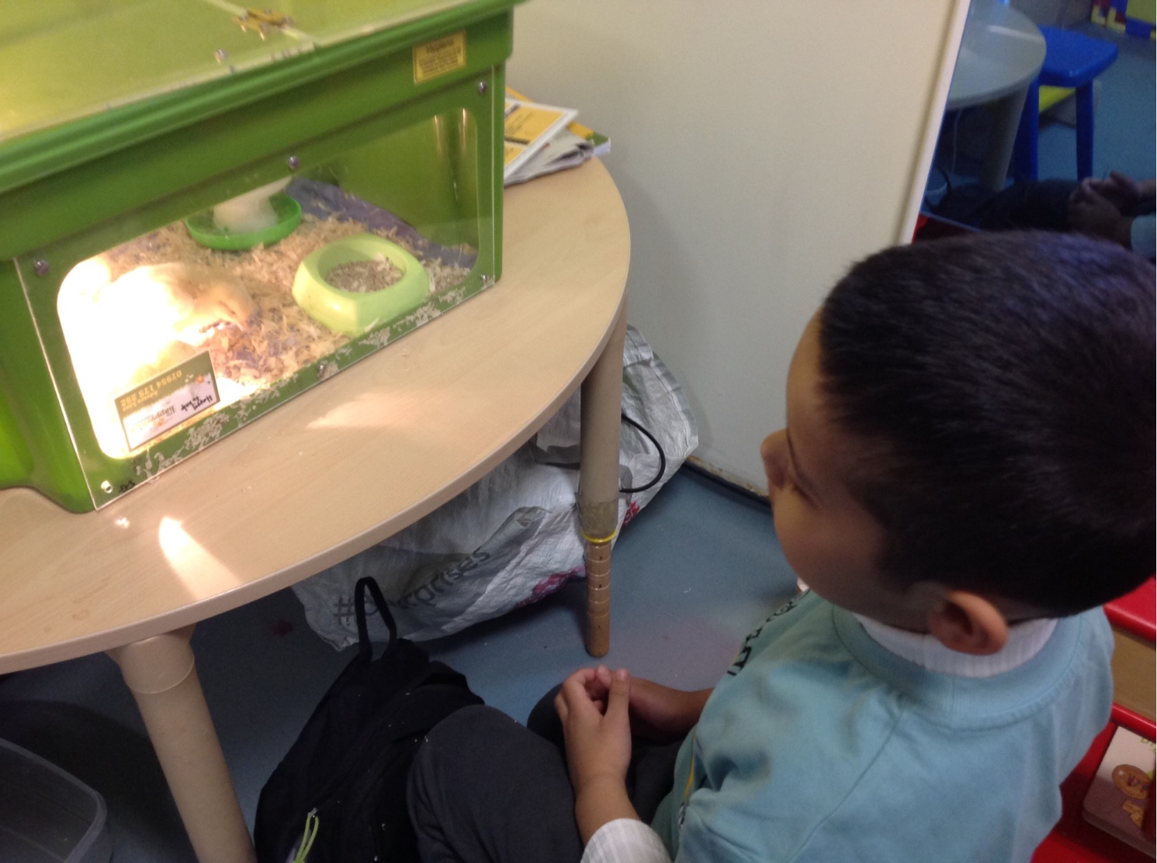
With a cheep cheep here, and a cheep cheep there,

Slide 4
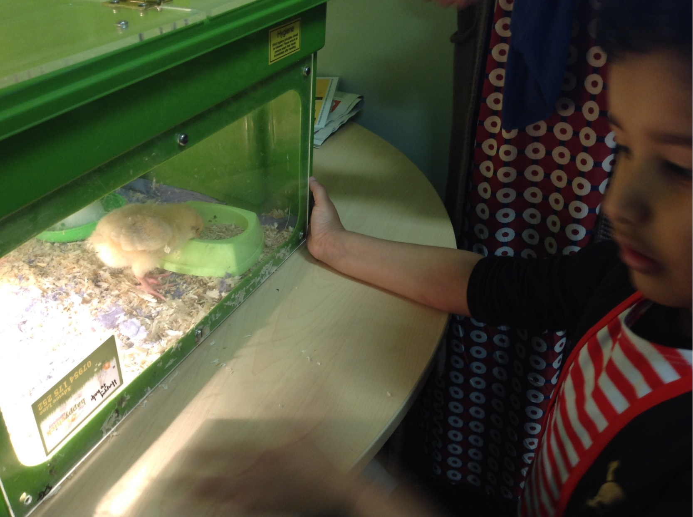
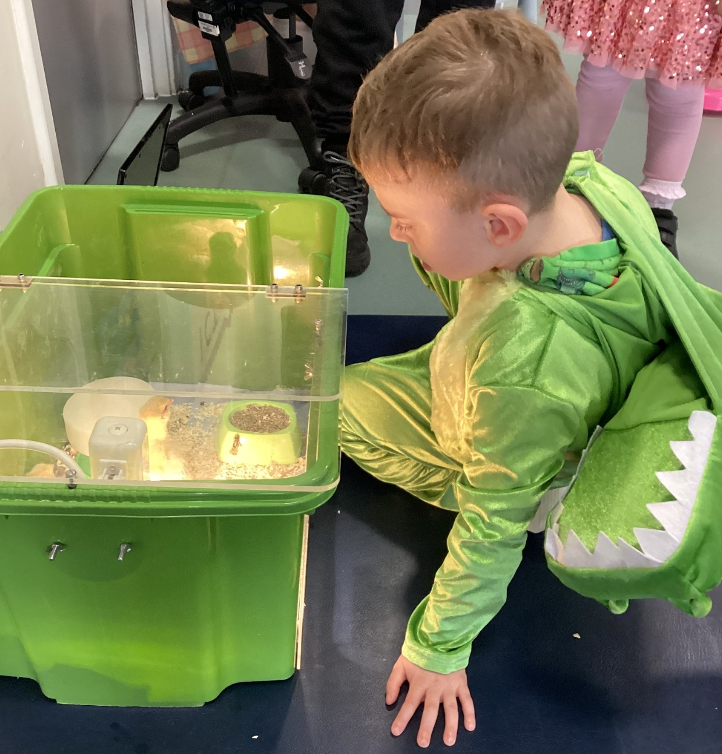
Here a cheep, there a cheep, everywhere a cheep cheep.

Slide 5
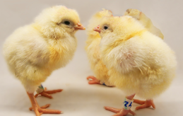
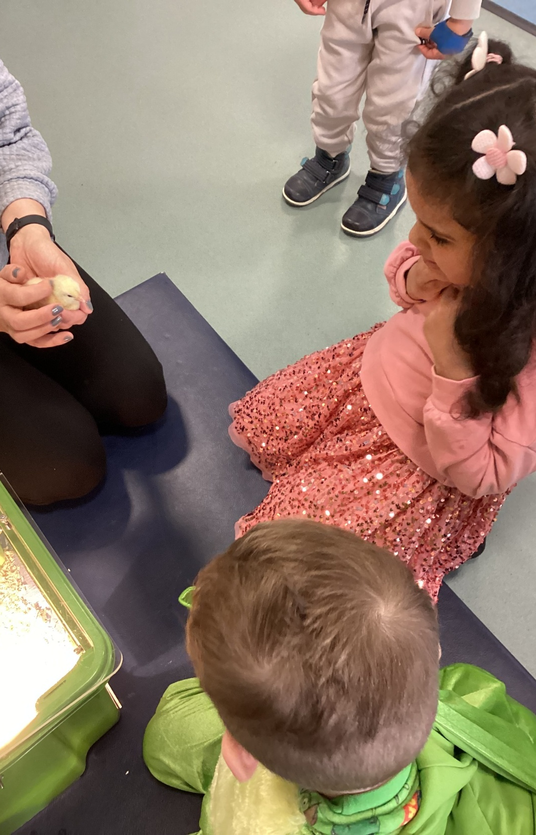
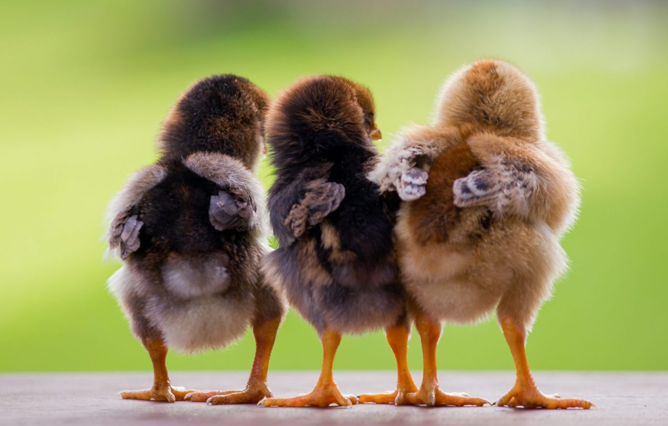
Old MacDonald had a farm
e-i-e-i-o.

