Slide 1
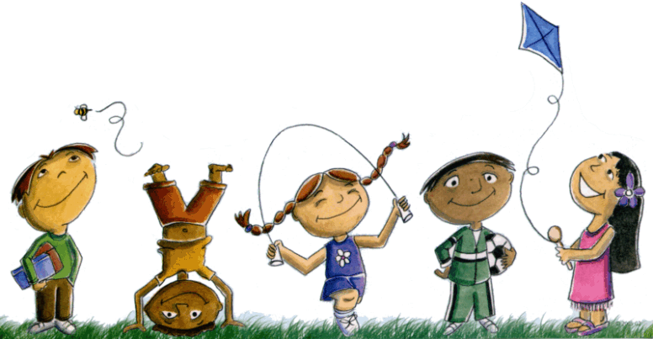
Schema: The Observation and Development of Play-In a ‘Free Flow, Child Led Learning Environment ‘

Slide 2
What are Schema ?
Schemas are patterns of repeated behaviour which allow children to explore and express developing ideas and thoughts through their play and active exploration.
Schema are an observational lens through which we can view and interpret the play activities that intrinsically motivate our children
Children need to practise their schema again and again in their self- directed play . They are the building blocks of knowledge as they use their schema to make sense of their world, building new neural pathways to facilitate cognitive processes . ( eg. first schema )
As children grow these schema increase in number and complexity.

Slide 3
Examples of Schema
Enclosure: putting things inside other things like objects into boxes, climbing into boxes or cupboards, filling containers.
Transforming: the urge to make things change – squish them, bang them, hit them, mix them. Holding food and rink in mouth, put sand in water tray, adding water to dirt.
Orientation: the need to be upside down, sideways, see what the world looks like from under the table or top of the hill
Trajectory : throwing, dropping things, sliding things along the floor, putting hand under running tap. Climbing and jumping. It can be vertical ,horizontal or diagonal . It can be to do with the trajectory of the child, objects or materials

Slide 4
Examples of Schema
Transporting: collecting objects and carry them around in their hands, bag, wheelbarrow etc.. They move things around from one place to another and can move them back again.
Connection: connect things together, pull them apart – lego. Build a tower and knock it down with blocks, boxes. Connecting things with sellotape and string.
Rotation: spinning on the spot , spinning in the saucer rolling along the floor,watching the washing machine, spinning wheels, watching wheels turn, circular mark making/scribbles.

Slide 5
Examples of Schema
Positioning – child likes to line things up, make patterns with objects, have things in a particular place
Enveloping – they have the urge to cover themselves/ roll themselves up in a blanket, envelop objects, they may open them up and then do it all again. Tents, hammocks, shelters

Slide 6
Creating a Free Flow Play environment with open ended resources
Schema are best practiced in a free flow play environment using open ended resources which enable practice of all the schema and also reflect the children’s interests ( see photos )
Children will show you what they know as they play. Open ended resources have endless possibilities allowing children to be creative and play in their own unique way

Slide 7
The role of the adult – Freedom with Guidance and ( Scaffolding Learning )
By observing children as they play and explore we can identify their schema
The role of the adult is to observe, develop and extend
Through observation ( video, photos ) of their schema and interests we can show progress over time and so further adapt the free flow learning/ play environment to meet and extend their learning
Develop and extend - follow the child’s lead by joining them in their play ( Intensive Interaction ) or scaffolding /modelling an extension to their play ( introduce ( but not using the time to directly teach a skill )
Zone of Proximal development - skills too difficult for a child to master on their own, but that can be done with guidance and encouragement from a knowledgeable person
Scaffolding – the way in which a more knowledgeable other can support a learner

Slide 8
What we have observed in our children’s play
The majority of children do not stay within one schema
They may combine schema
They may flit from one to another
They may have one schema that is dominant.
A few may stay with one schema throughout

Slide 9
What can we do with knowledge of a child’s schema
We can identify the schema the child is interested in and use our findings to extend and further develop their learning. ( schema extension )
We are more likely to be in tune with our children and understand the way in which they want to play , think and learn
We can share their play interests and can offer learning experiences that reflect and support their interests.

Slide 10
Example of Developing learning
Pupil
Likes to pull a trolley around the area or sit in the trolley to be transported around with a friend (Transporting)
Extend this activity by turning it into a treasure hunt - to locate and collect a number of logs in order to then build a tower together ( Transporting, connecting, trajectory)

Slide 11
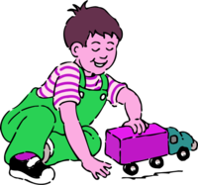
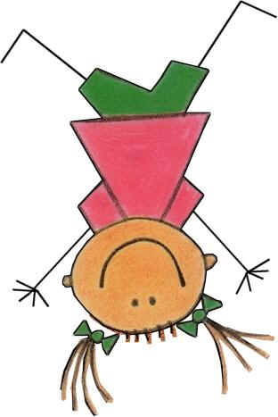

Look at the following pictures
Can you identify the Schema ?

