Slide 1
Creating an Outdoor Learning Environment: The Outdoor classroom is of equal value to the Indoors.
All seven areas of learning can come together in a relevant and meaningful way.

Slide 2
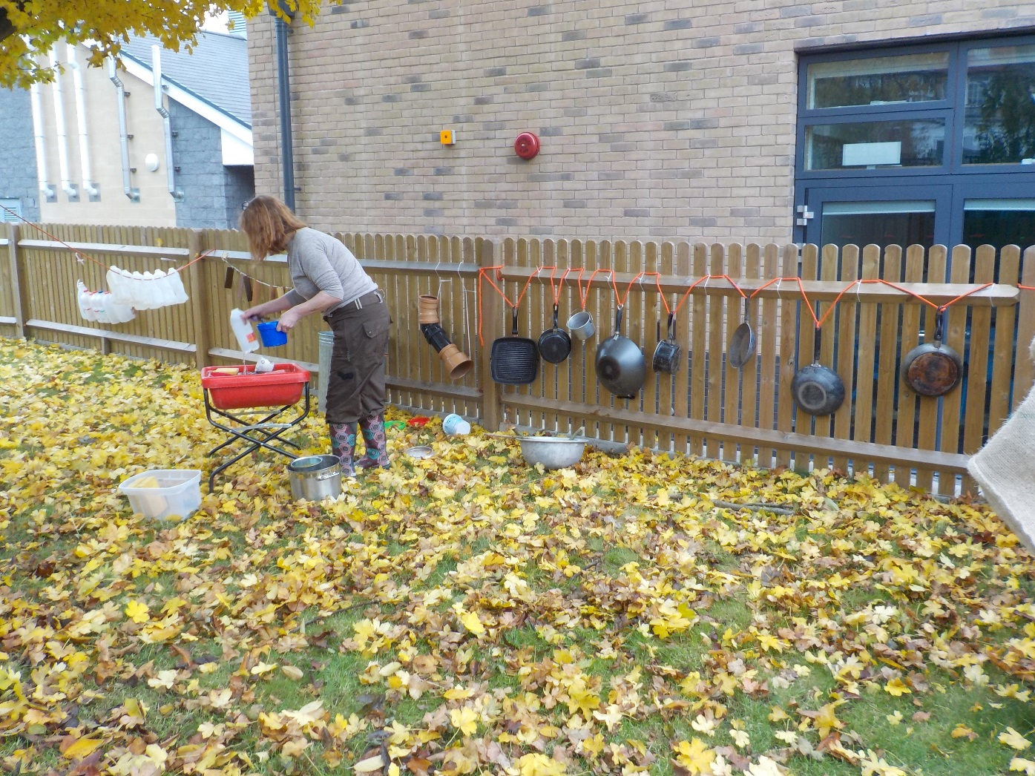
Water play and music area using loose parts.

Slide 3
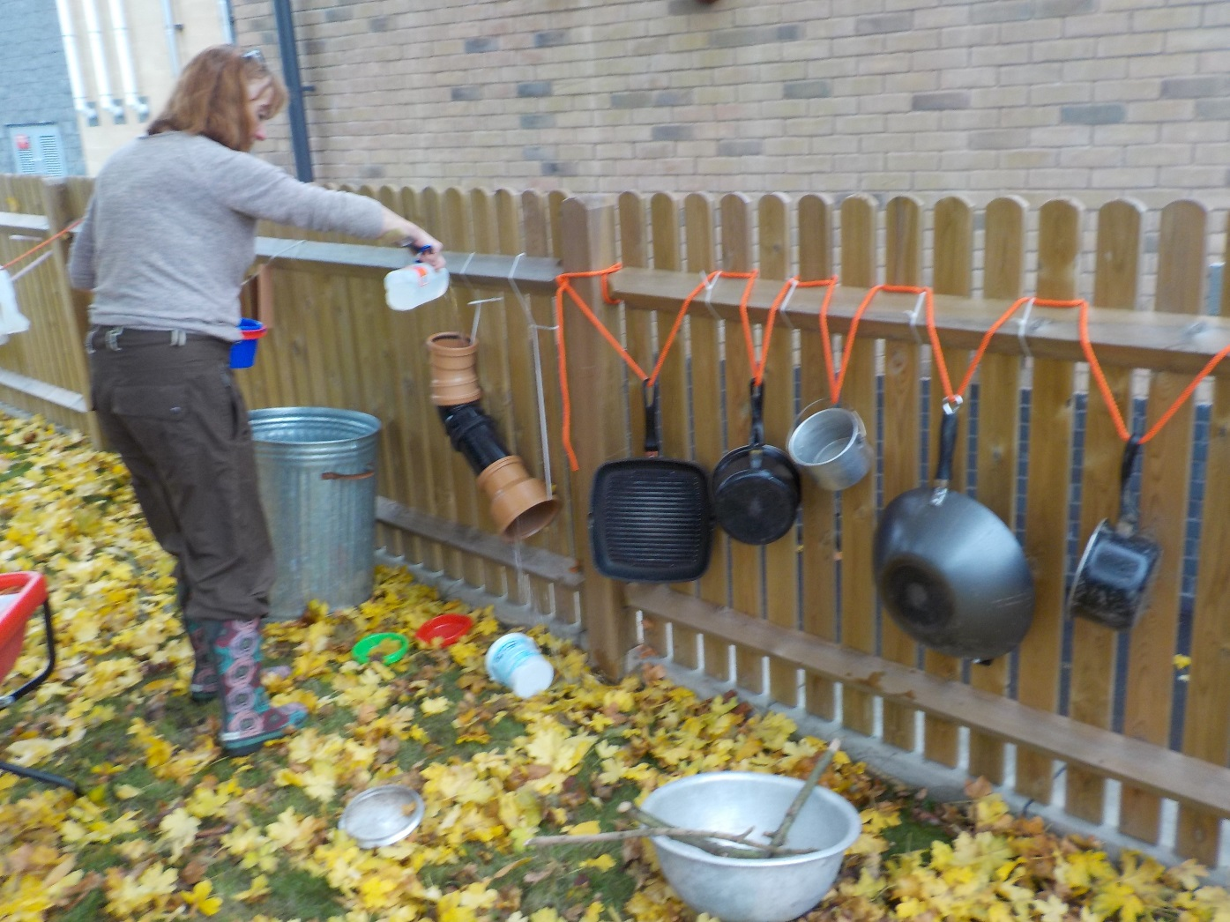
Trying out the water play funnel before the session.

Slide 4
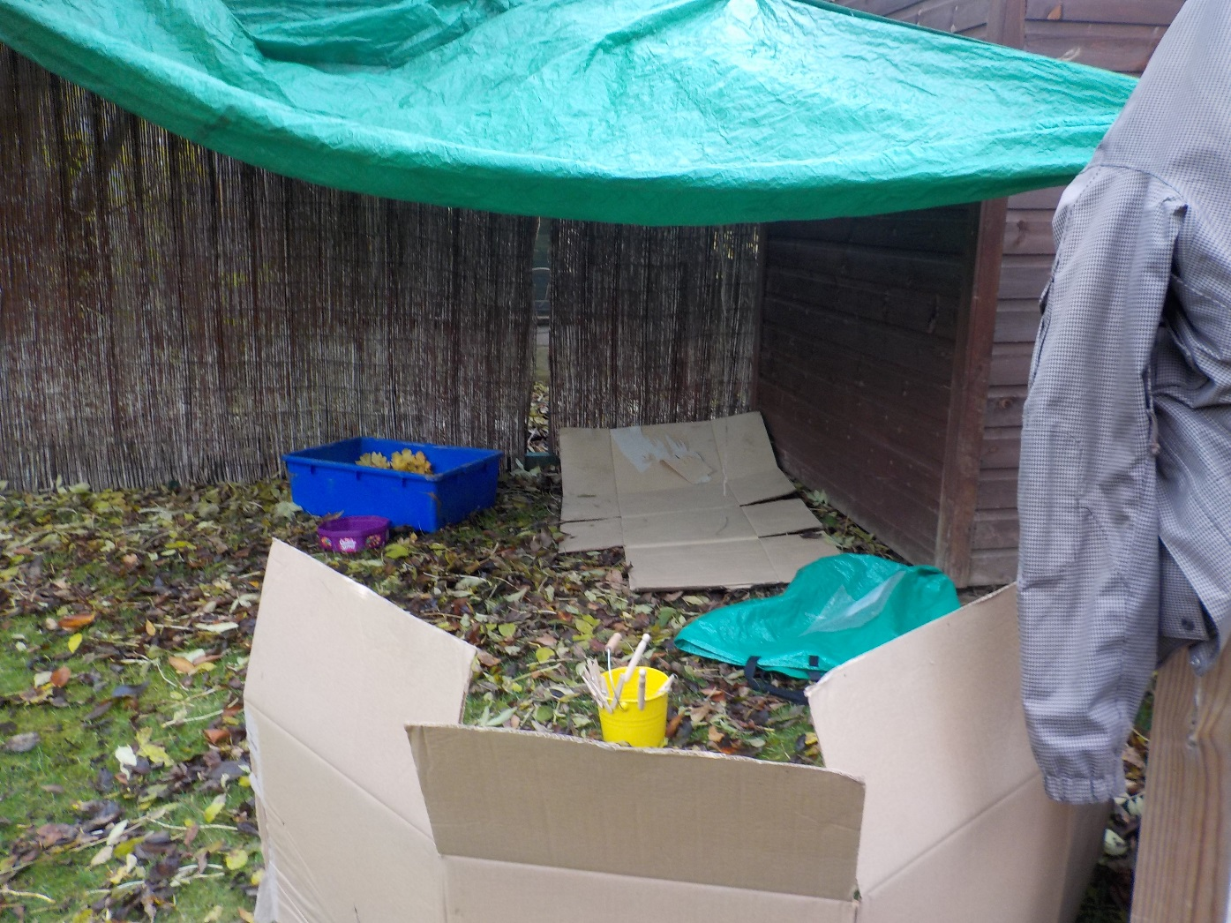
A natural shelter with containers full of leaves.

Slide 5
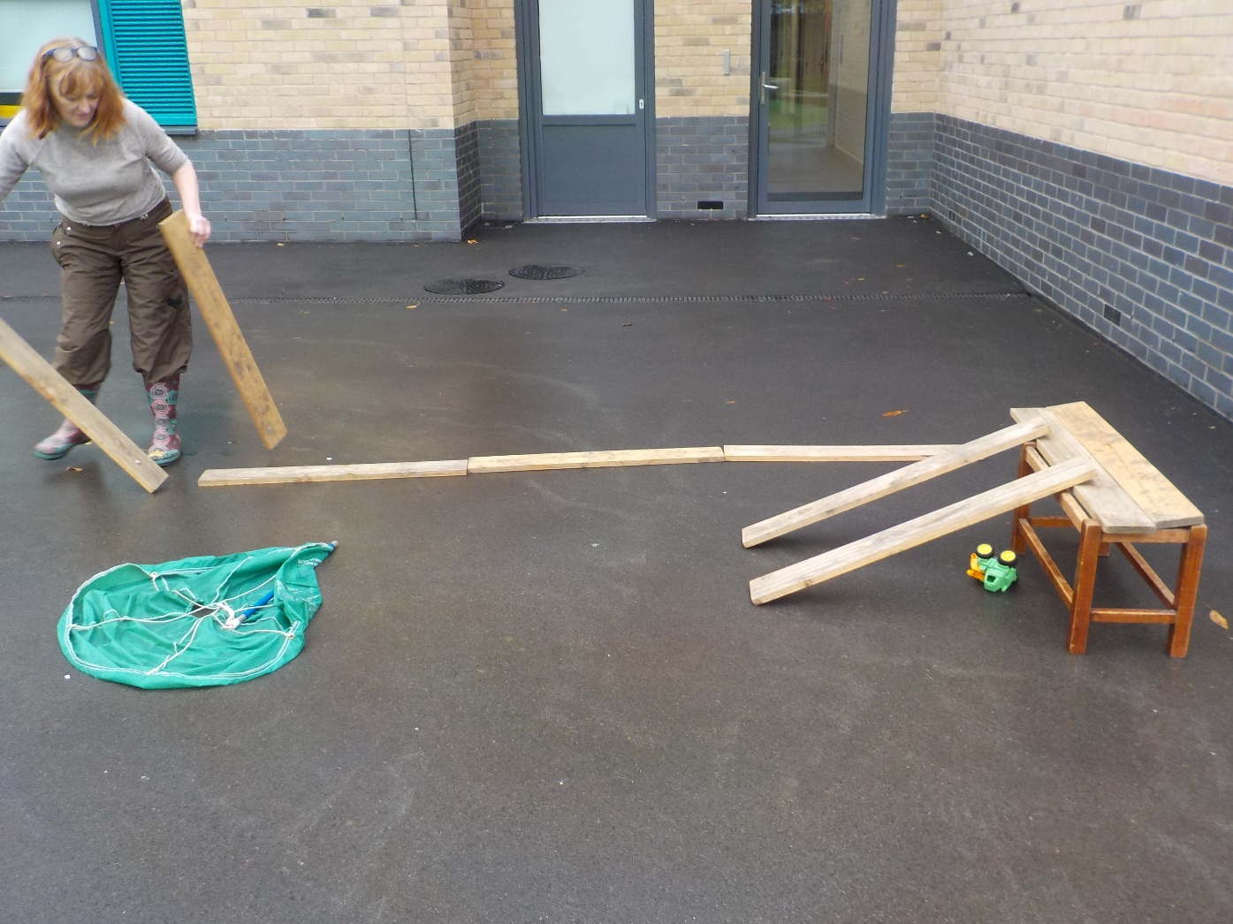
Plank play to walk along, play with cars, line up or create a slope.

Slide 6
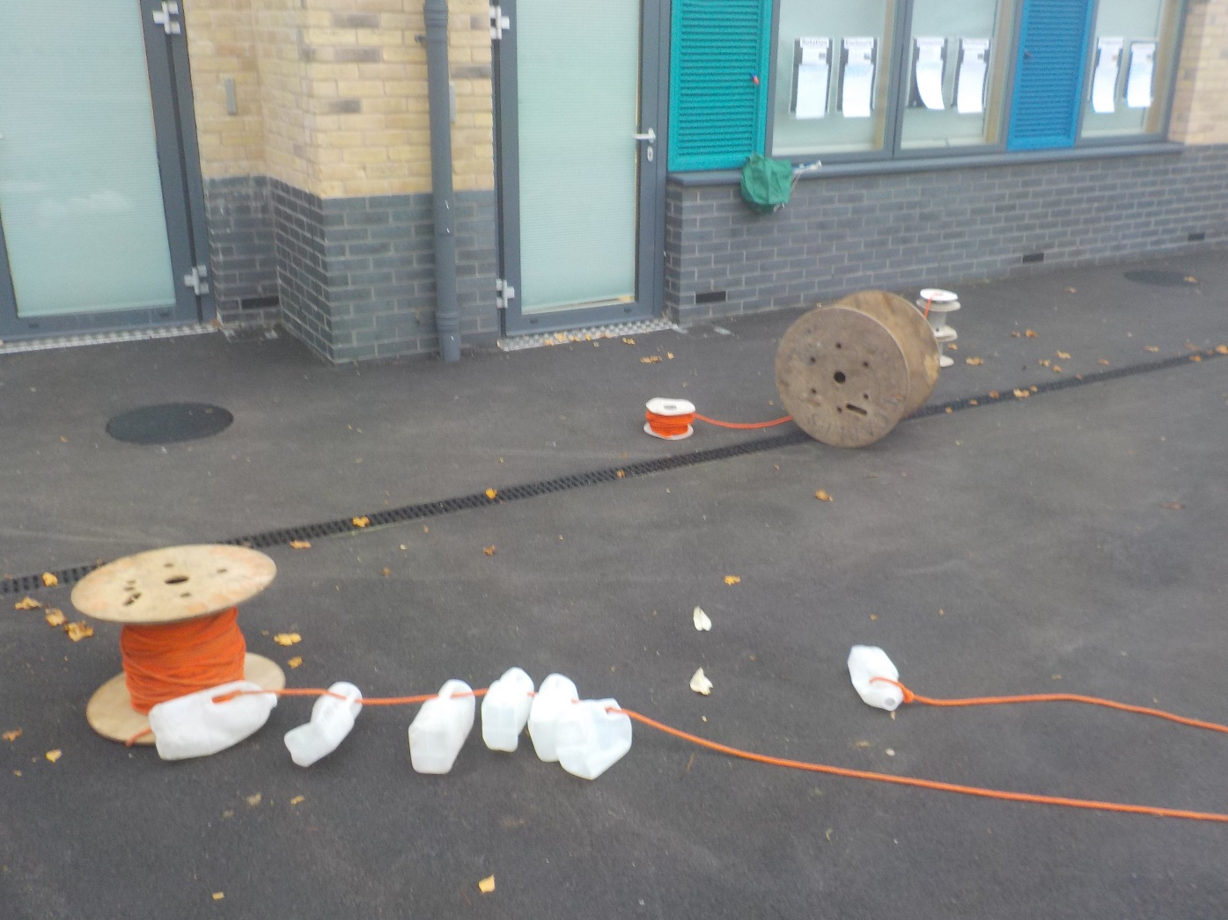
Rope and milk bottles have many possibilities.

Slide 7
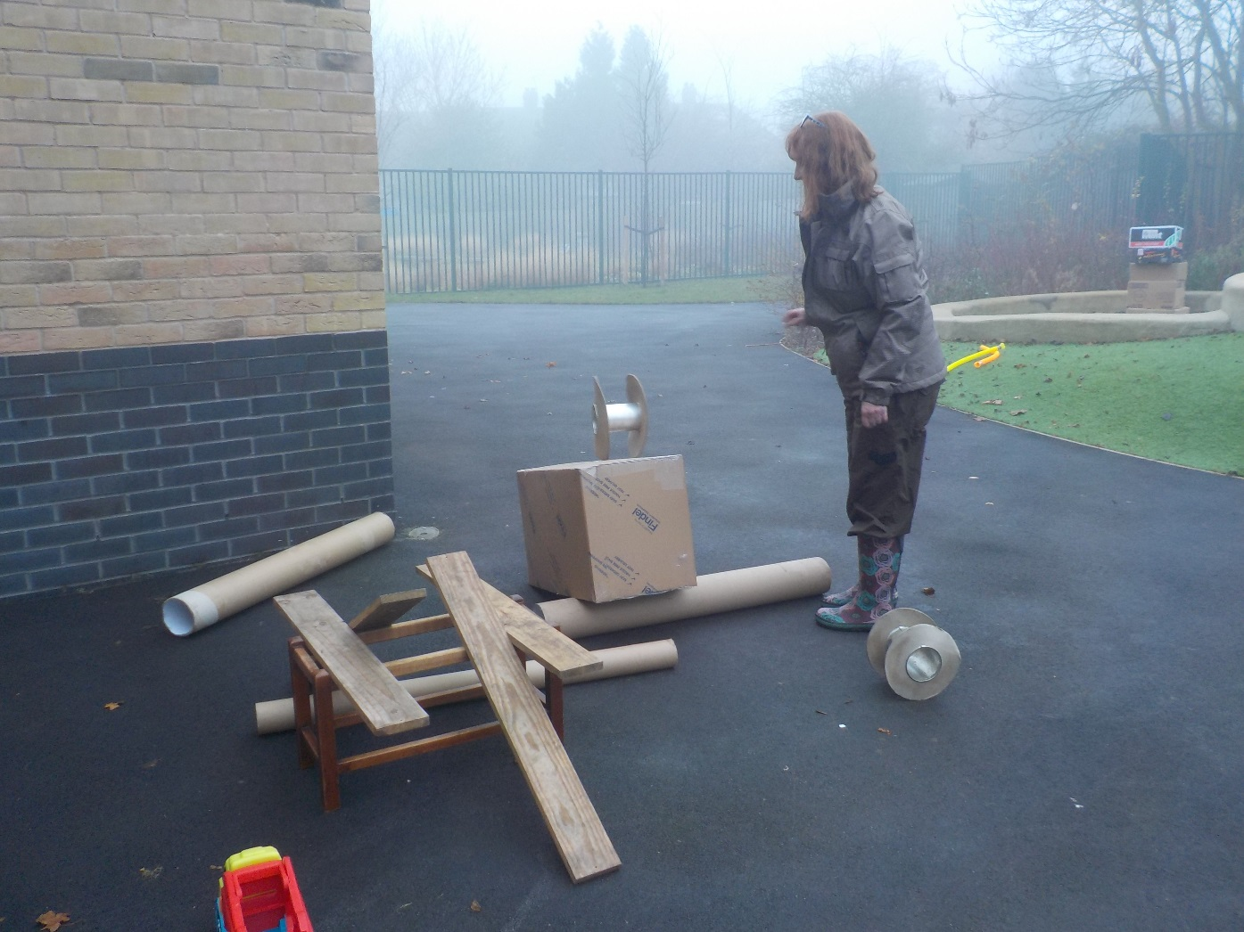
Trying out the ramp with cars and reels.

Slide 8
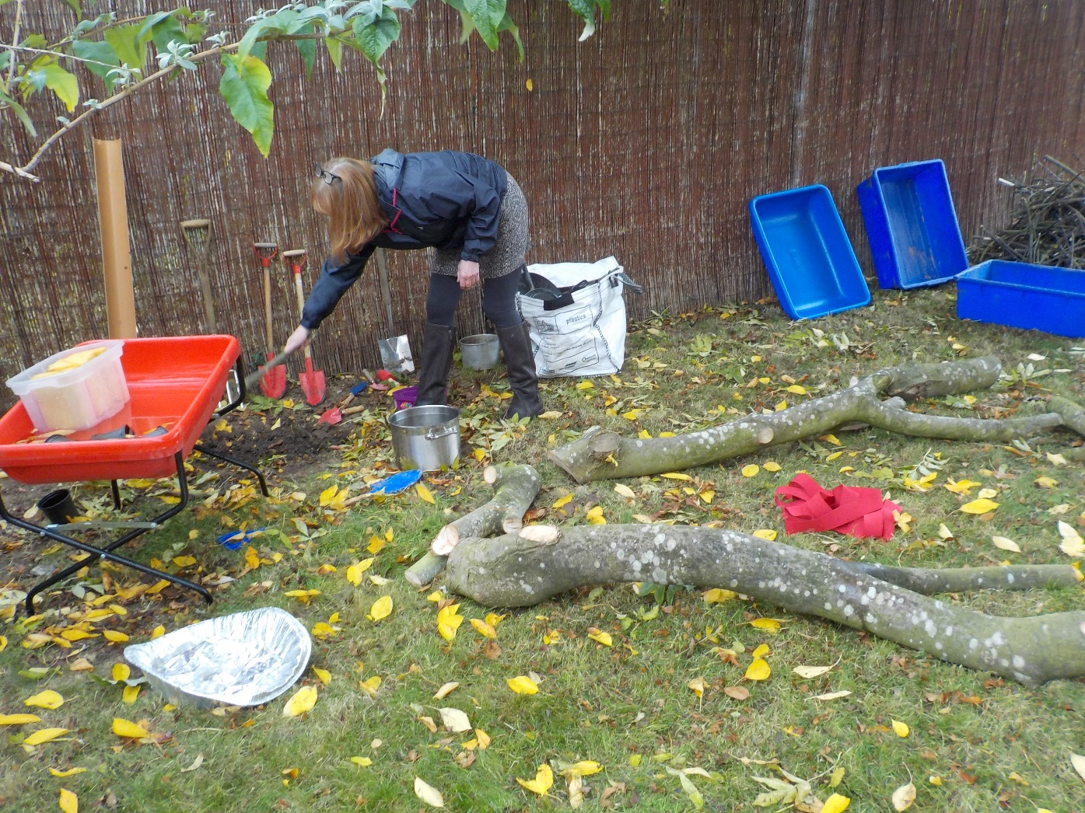
Creating the possibilities for mud and waterplay and coming together.

Slide 9
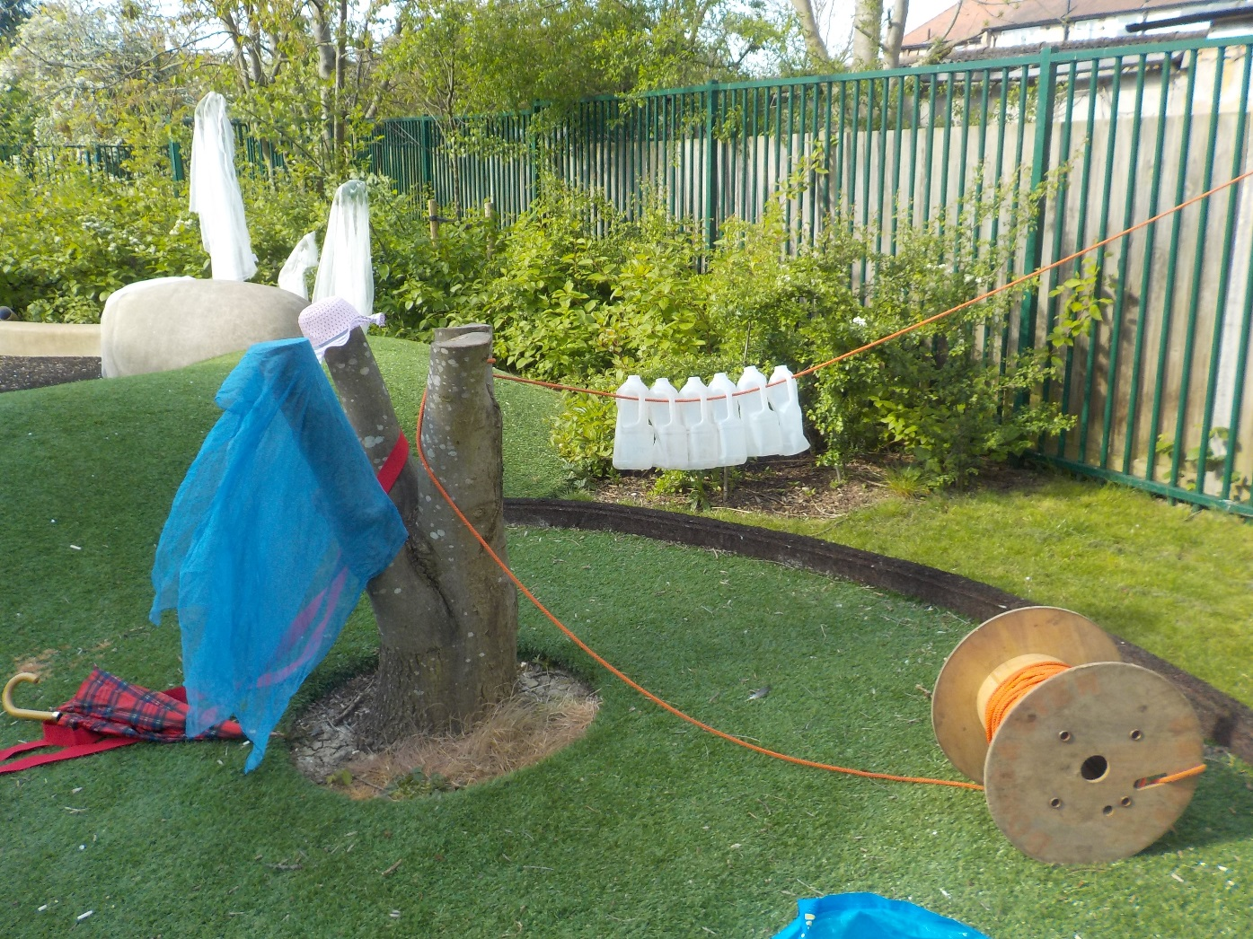
Making use of everyday objects

Slide 10
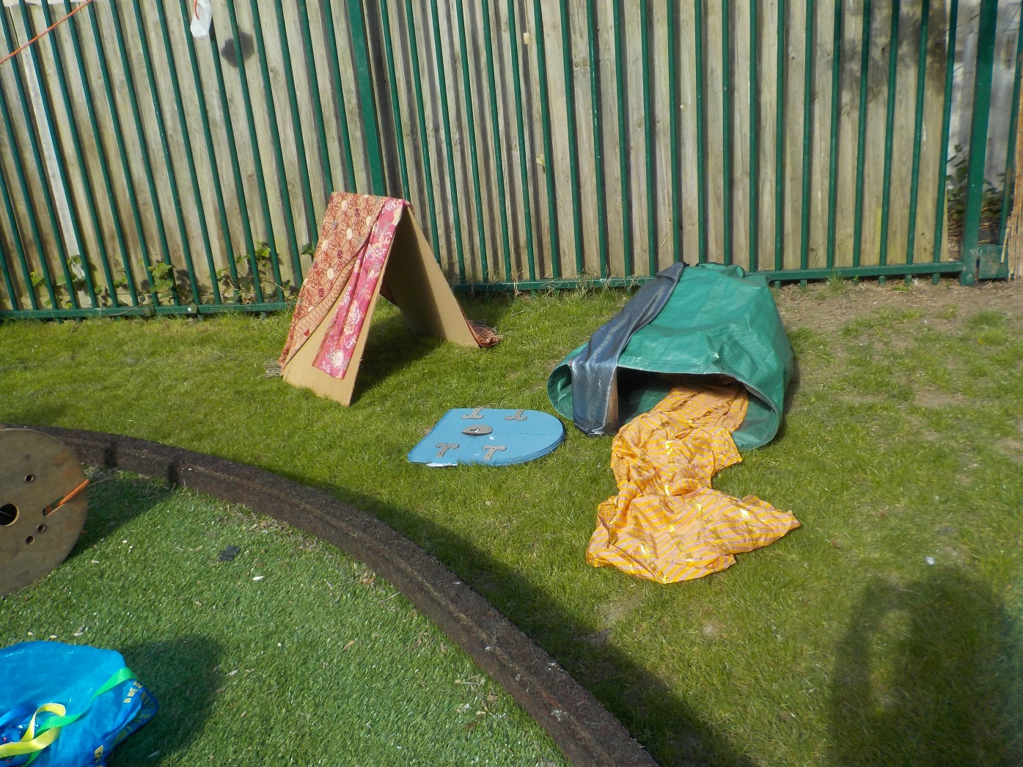
Have fun with material

Slide 11
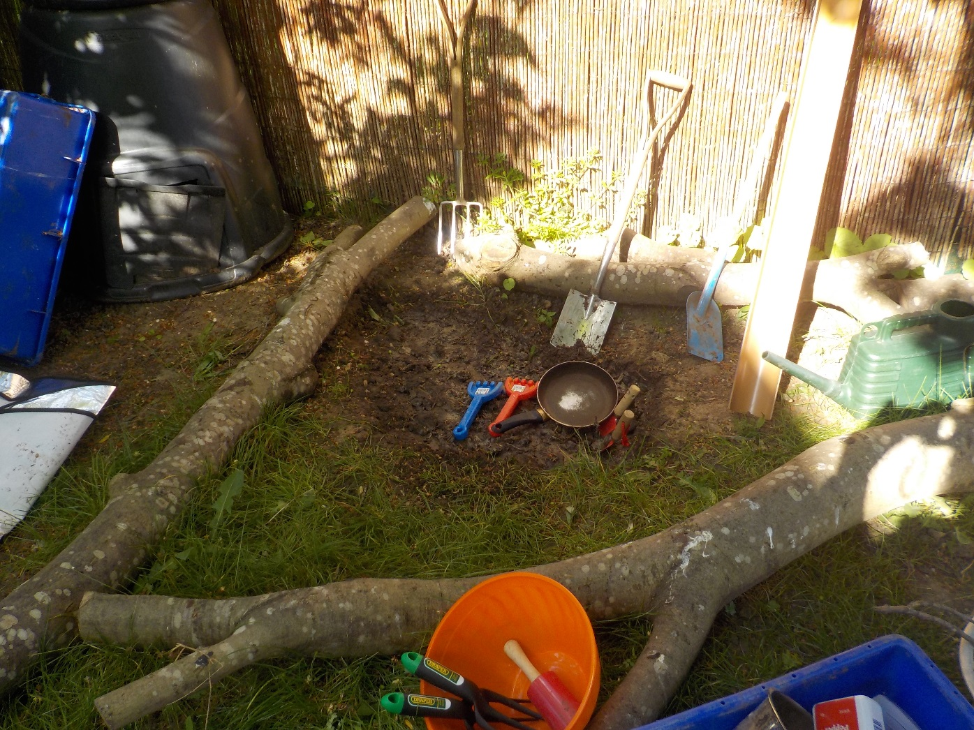
Mud, mud, glorious mud!

Slide 12
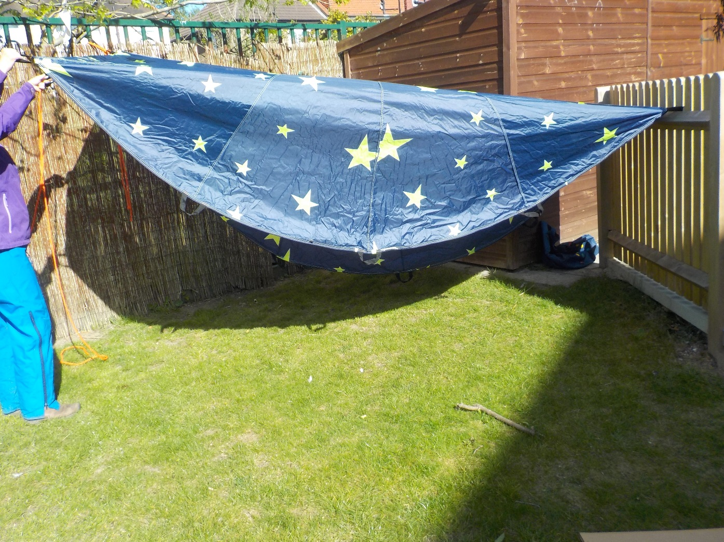
Let’s make a den

